Slide 1
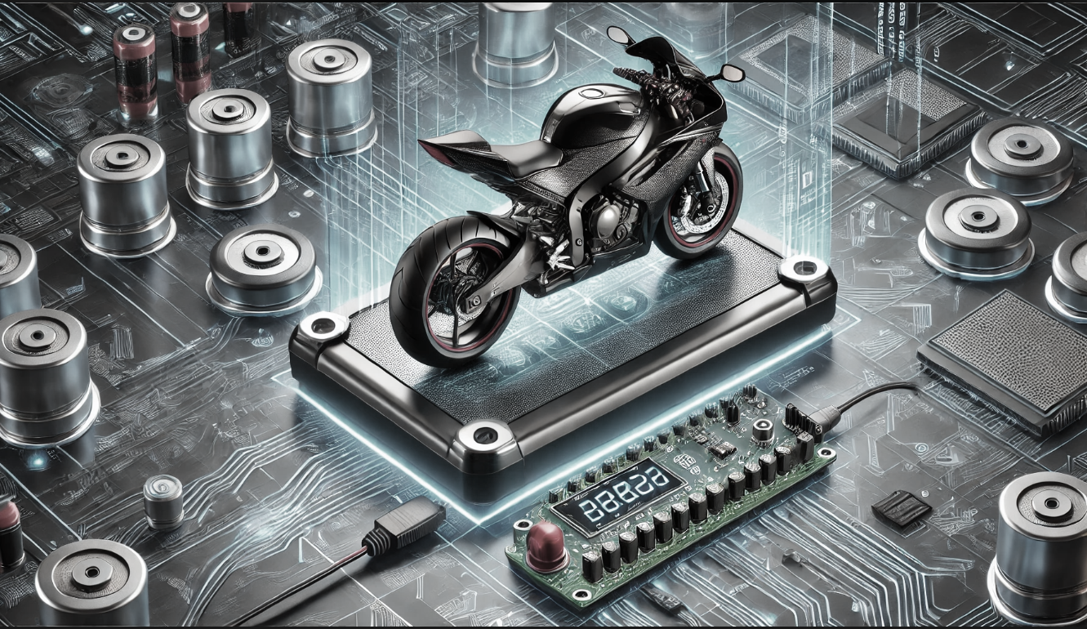
Intelligent Passenger Load Monitor
SIDENTRY

Slide 2
SIDENTRY
Intelligent Load cell Monitor
Solution :
A Bike Weight Detection System using Load Cell, Arduino, and Buzzer ensures safety by:
Detecting the total weight on the bike.
Processing weight data through an Arduino.
Activating a buzzer alert if the bike is overloaded.
Preventing the bike from starting if the weight limit is exceeded.
This system promotes safe riding practices and reduces accident risks.
Problem Statement :
Overloading bikes is a serious safety hazard.
Excessive weight can lead to:
Increased risk of accidents.
Damage to bike components.
Poor fuel efficiency.
Many riders unknowingly overload their bikes,
leading to dangerous situations.

Slide 4

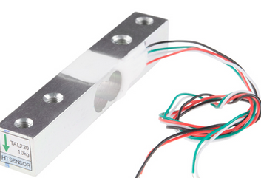
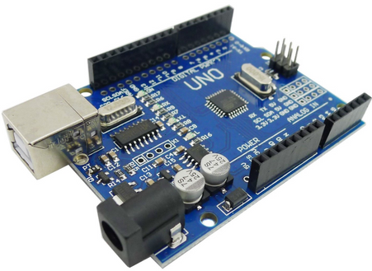
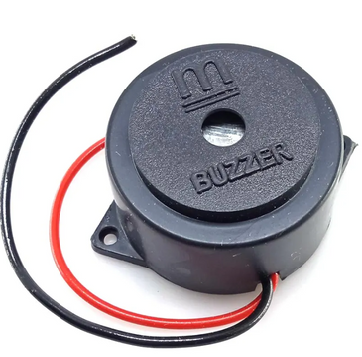
SIDENTRY
Intelligent Load cell Monitor
Conponents Used :
Load cell
Load cell Amplifier
Arduino Uno
16 * 2 LCD Display
Buzzer
Jumper wires
Load Cell – Measures the total weight on the bike.
Arduino – Processes the weight data and decides if the load is within limits.
Buzzer – Alerts the rider when the bike is overloaded.

Slide 5

SIDENTRY
Intelligent Load cell Monitor
Load Cell – Measures the total weight on the bike.
Arduino – Processes the weight data and decides if the load is within limits.
Buzzer – Alerts the rider when the bike is overloaded.

